Slide 1
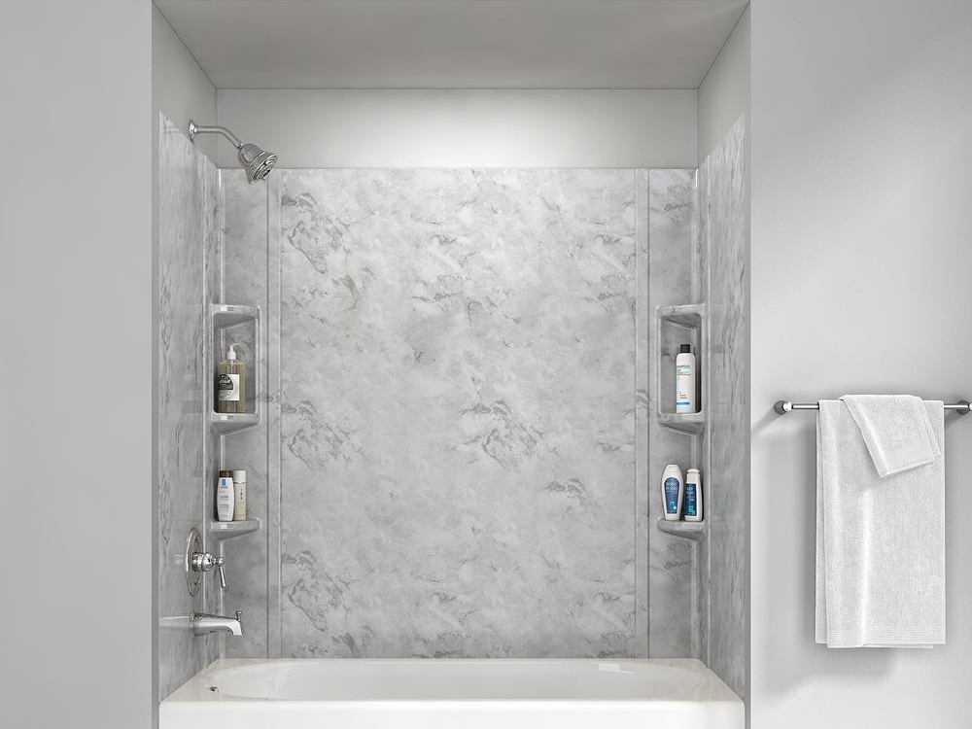





70° F|C
84 ° / 65 °
Humidity: 57%
08:09 AM
Friday, October 2019

Slide 2

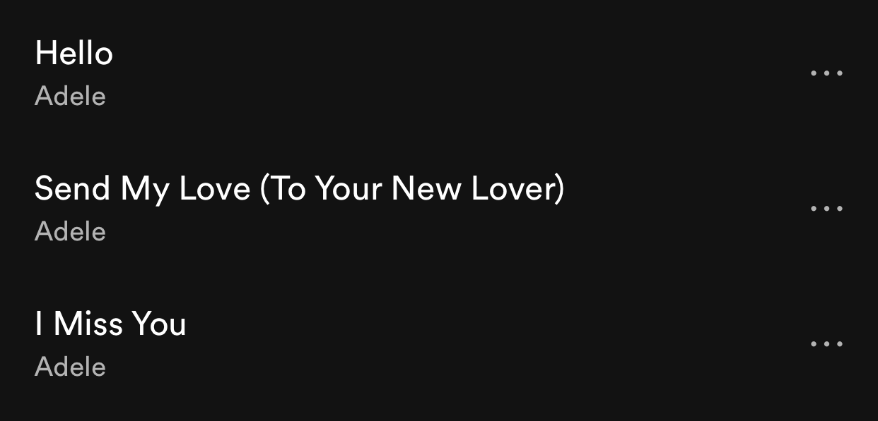
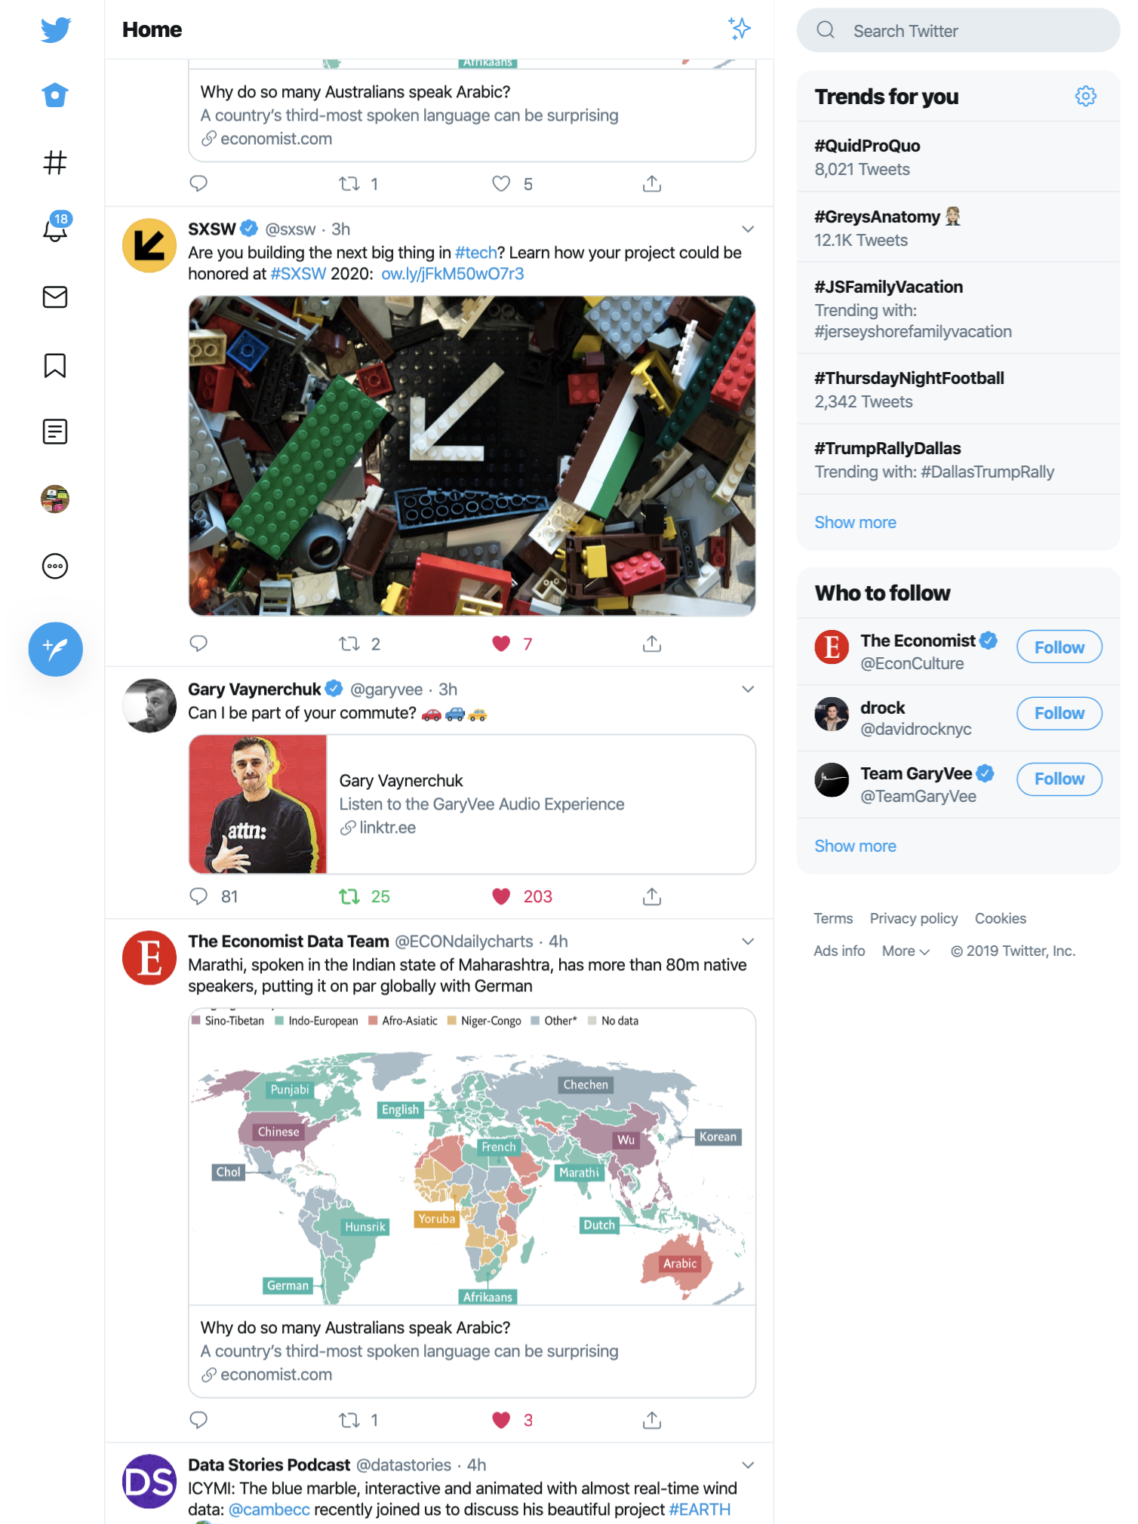
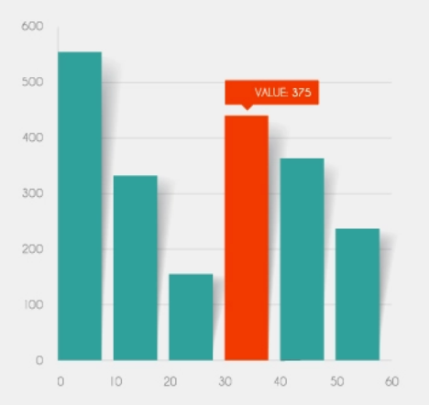
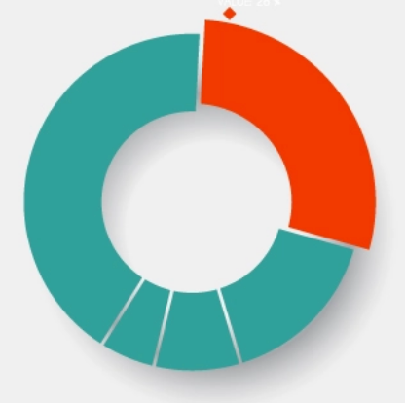
70° F|C
84 ° / 65 °
Humidity: 57%
08:10 AM
Friday, October 2019
Good morning, Alex!
Hello・Adele – 25
Upcoming events
Exercise | 8:30 - 9:00 AM
Work | 9:30 - 11:45 AM
Lunch | 12:00 - 12:45 PM
)
)))
To: Bob
Morning. Let’s meet at 10.
Okay!
Sleep hours
Steps per day

